Slide 1
Ghent University
Virtual Staining for histology by Deep Learning
Seoeun Jang
02315545

Slide 2
Seoeun Jang
Contents
01
02
03
Introduction
Virtual Staining
Workflow
Histology · Staining Need · Conventional Limits
Definition · Types · Advantages
Collection · Training · Validation
04
05
06
Technical Mechanism
Limitations
Future Directions
Pix2Pix · CycleGAN
Dataset · Hallucination · Generalization
Standardization · ViT-Stain
Virtual staining for histology by deep learning
Page 2/11

Slide 3
01. Introduction
Seoeun Jang
Histology and Staining
Histology
the study of the microscopic structure of tissues.
Staining
Method | Representative example
General morphology staining | H&E staining: Shows basic tissue structures such as nuclei, cytoplasm, and tissue arrangement.
Immunostaining | IHC: Shows the location and expression of specific antigens, proteins, or disease-related markers.
Special staining | PAS staining: Shows carbohydrate-related components such as glycogen, mucin, and basement membrane.
Virtual staining for histology by deep learning
Page 3/11

Slide 4
02. Virtual staining
Seoeun Jang
Virtual Staining
Virtual staining is a deep learning-based technique that digitally generates stained histological images from unstained tissue images, or converts one stain type into another.
- Types
1. Unstained to stained:
Generating stained images, such as virtual H&E, from unstained tissue images.
2. Stain-to-stain transformation:
Converting an already stained image into another stain type, such as H&E to PAS.
3. Virtual IHC staining:
Digitally generating immunohistochemical staining to show specific protein markers, such as HER2 or Ki-67.
Virtual staining for histology by deep learning
Page 4/11

Slide 5
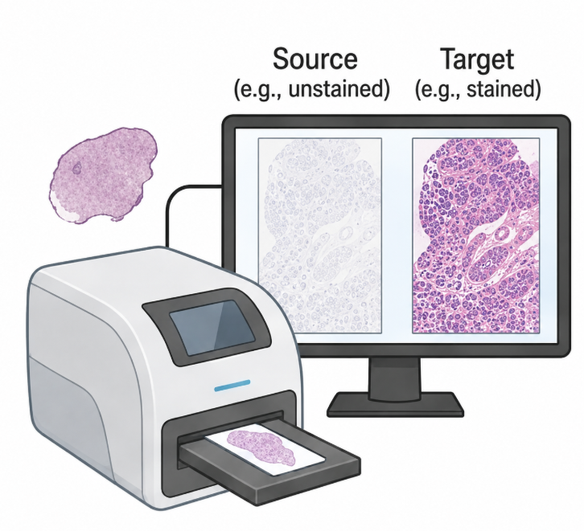
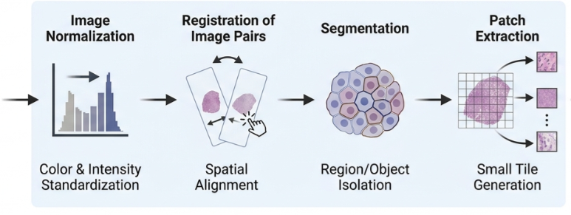
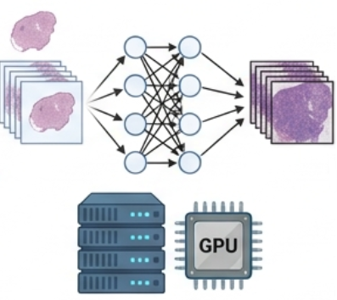

03. Workflow
Seoeun Jang
Workflow of virtual staining
Computational Validation
Histological Validation
Task-Specific Validation
Data collection
& Curation
Preprocessing
Network
Training
Validation
Virtual staining for histology by deep learning
Page 5/11

Slide 6
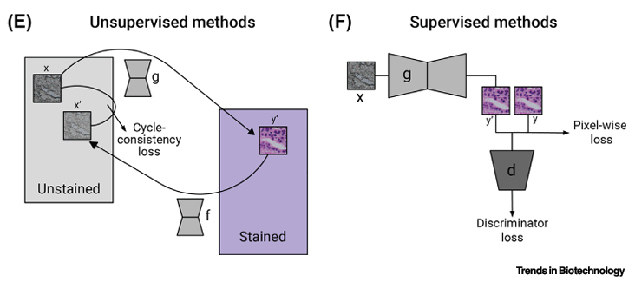
04. Technical mechanism
Seoeun Jang
Technical Mechanism
Supervised (Pix2pix) | Unsupervised (CycleGAN)
- Uses paired and registered source target images - Learns direct unstained → stained mapping - Uses pixel-wise loss and discriminator loss | - Uses unpaired unstained and stained image sets - Learns domain-to-domain stain translation - Uses cycle-consistency loss to preserve tissue content
Virtual staining for histology by deep learning
Page 6/11

Slide 7
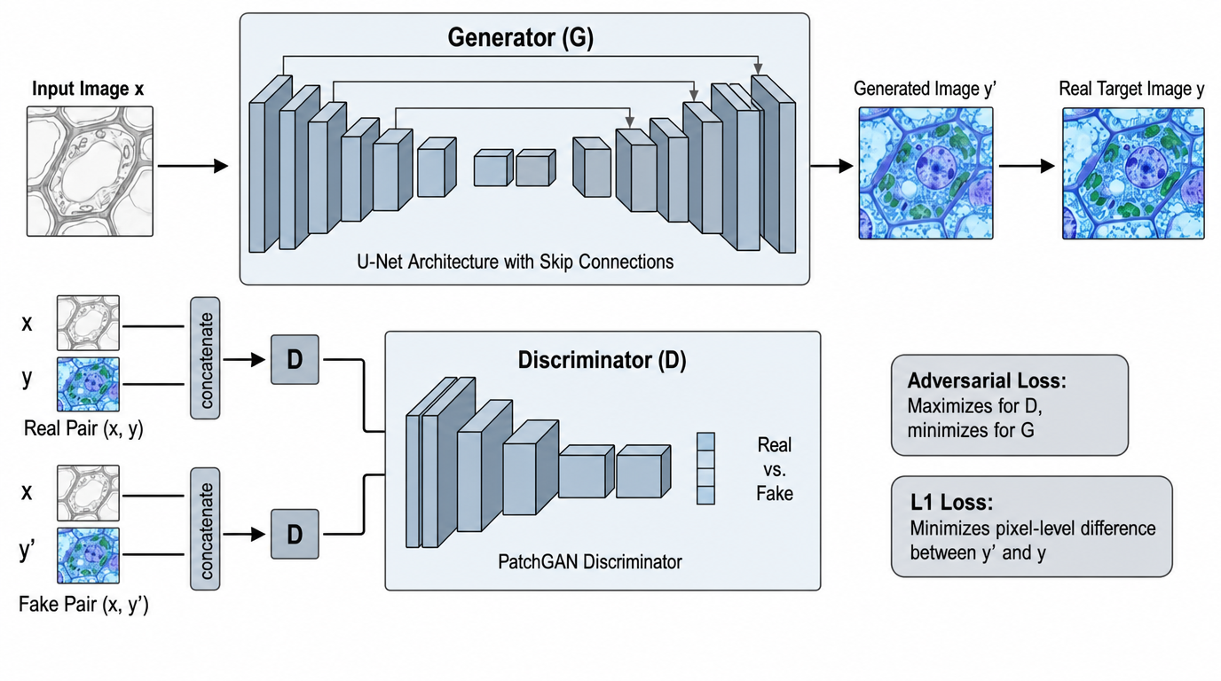
04. Technical mechanism
Seoeun Jang
Supervised model – Pix2pix
Utilizes paired data for image-to-image translation. It learns the mapping by training on 1:1
correspondences between two domains, such as unstained and stained tissue images.
Virtual staining for histology by deep learning
Page 7/11

Slide 8
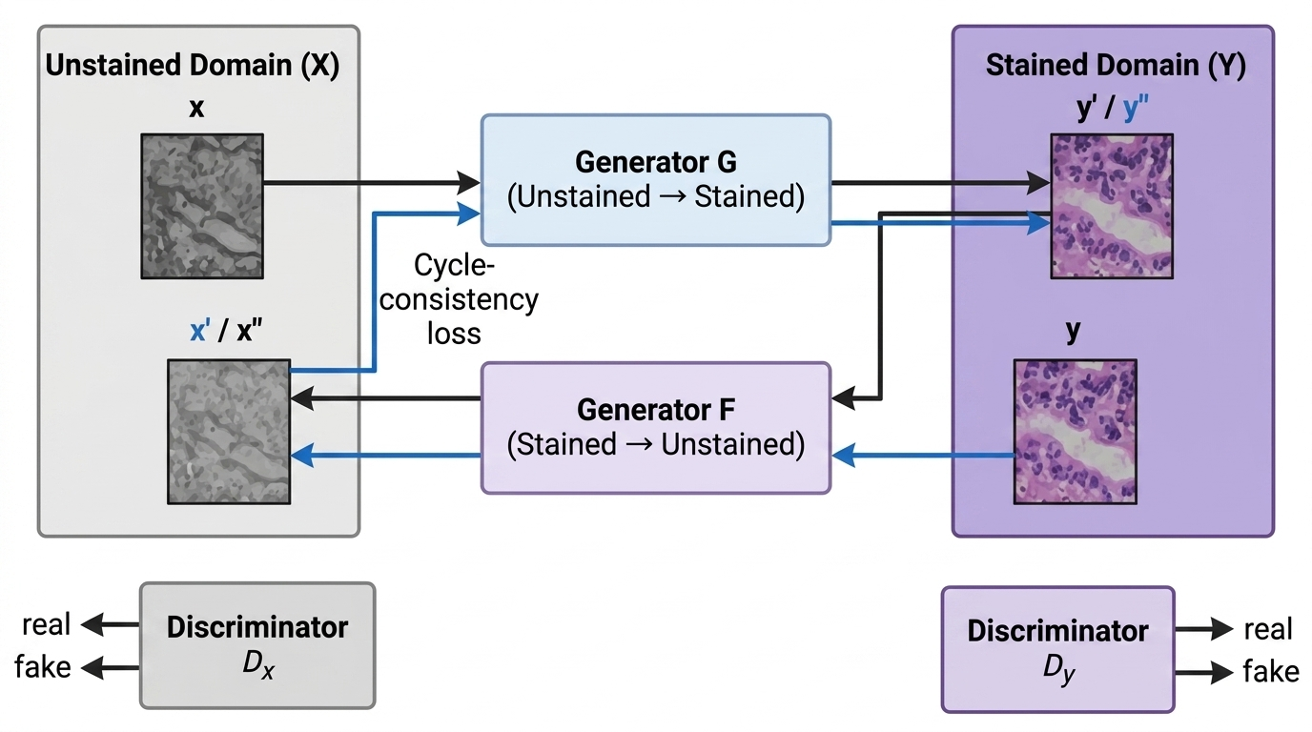
04. Technical mechanism
Seoeun Jang
Unsupervised model – CycleGAN
Performs domain translation using unpaired data. It does not require 1:1 matched images, making it highly effective for scenarios where paired data is difficult to obtain.
Virtual staining for histology by deep learning
Page 8/11

Slide 9
05. Limitations
Seoeun Jang
Limitations
Validation and Generalization
Requires strong validation; performance may vary across stains, tissues, proteins, and pathologies.
2. Data & Imaging Issues Needs large representative datasets; unstained tissues are low-contrast and difficult to scan.
3. Technical & AI artifacts Tiling, registration errors, and hallucinations can produce misleading virtual staining results
Virtual staining for histology by deep learning
Page 9/11

Slide 10
06. Future directions
Seoeun Jang
Future Directions
Most Promising Target: H&E
- H&E is the routine standard and the most developed virtual staining target.
- Reliable virtual H&E can support expansion to other stains.
Requirements for Broader Applications
- Standardization: Different scanners, resolutions, evaluation methods make model comparison difficult.
- Open WSI datasets: Can improve reproducibility and generalization
- Hardware optimization: Scanners should be optimized for low-contrast unstained tissues, with faster inference for clinical use.
Example Approach: ViT-Stain
- Uses patch tokens and global self-attention to understand the overall tissue stucture
- Connects distant tissue regions to understand the whole tissue structure
- Helps prevent false tissue details and makes the virtual stain more consistent
Virtual staining for histology by deep learning
Page 10/11

Slide 11
References
Fischer, A. H., Jacobson, K. A., Rose, J., & Zeller, R. (2008). Hematoxylin and eosin staining of tissue and cell sections. Cold Spring Harbor Protocols, 2008(5), pdb.prot4986. https://doi.org/10.1101/pdb.prot4986
Hussain, M. A., Waris, M. A., Akram, M. U., Khan, M. J., Asaf, M. Z., Javaid, A., Gilani, S. O., & Hazzazi, F. (2026). ViT-Stain: Vision transformer-driven virtual staining for skin histopathology via global contextual learning. PLOS One, 21(2), e0341311. https://doi.org/10.1371/journal.pone.0341311
Isola, P., Zhu, J.-Y., Zhou, T., & Efros, A. A. (2017). Image-to-image translation with conditional adversarial networks. In Proceedings of the IEEE Conference on Computer Vision and Pattern Recognition (CVPR) (pp. 1125–1134). https://doi.org/10.1109/CVPR.2017.632
Magaki, S., Hojat, S. A., Wei, B., So, A., & Yong, W. H. (2019). An introduction to the performance of immunohistochemistry. Methods in Molecular Biology, 1897, 289–298. https://doi.org/10.1007/978-1-4939-8935-5_25
Manoj, M. G., & Shelly, D. (2016). Periodic acid Schiff’s: A definitive stain in histopathological diagnosis of cylindroma. Medical Journal Armed Forces India, 72(4), 404–406. https://doi.org/10.1016/j.mjafi.2016.07.007
Zhu, J.-Y., Park, T., Isola, P., & Efros, A. A. (2017). Unpaired image-to-image translation using cycle-consistent adversarial networks. In Proceedings of the IEEE International Conference on Computer Vision (ICCV) (pp. 2223–2232). https://doi.org/10.1109/ICCV.2017.244
Virtual staining for histology by deep learning
Page 11/11

